Slide 1
Databases SQL
Introduction to SQL

Slide 2
Introduction To Databases
SQL
Modelling Relational Databases
NoSQL Databases
There are many different kinds of databases.
Each one has advantages and disadvantages meaning that they should be used for different situations.
We will explore several different types of database over this course but be aware there are many more!

Slide 3
What is a Database?

Slide 4
Databases
Organised collection of data
Many different kinds
Contains a number of different objects
Tables – columns and rows of data
Schemas – structure of the data
Queries – getting data we want from the database
Views – results from a stored query
Typically based on information we would want from the physical world
Generally model in a way to answer some sort of question with information

Slide 5
Task 1: Installing MySQL

Slide 6
Environment variables
To make things a bit simpler we are going to create an environment variable for MySQL
This means we will be able to run MySQL straight from the command prompt
The environment variable will basically tell the computer where MySQL is installed
Check to see where you installed MySQL so you know the path
It will likely be something like C:\Program Files\MySQL\MySQL Server 5.7\bin

Slide 7
Task 2: Adding Environment Variable & Interacting with MySQL

Slide 8
Querying

Slide 9
SQL
SQL is actually separated into 3 different sections called languages and a programming interface to tie them all together.
Data Definition Language – DDL
Used to Manipulate the Database Schema
CREATE, ALTER, DROP
Data Manipulation Language – DML
Used to Manipulate the table rows
SELECT, INSERT, UPDATE, DELETE
Data Control Language – DCL
Used to control access to tables
GRANT, REVOKE
Programming Interface

Slide 10
Data types
Essentially there are 3 key types and how you use the sub-types within this will determine your efficiency
Numeric
Text
Date/Time

Slide 11
Data types - numeric
Before we can begin querying we should understand what type of data we can work with
And before we begin with numeric types we need to know what the difference between signed and unsigned is
Every numerical type has a range of values it can be as we will see and this usually ranges from a negative number to a positive number e.g. -128 to 127
If we create a data type as UNSIGNED it will have that size range still but will start at 0, so -127 to 128 changes to 0 to 255

Slide 12
Data types - numeric
BIT: ranges from 1 to 64
TINYINT: ranges from -128 to 127
BOOL, BOOLEAN: Essentially just TINYINT(1). 0 is false, true is nonzero
SMALLINT: -32768 to 32767
MEDIUMINT: -8388608 to 8388607
INT, INTEGER: -2147483748 to 2147483647
BIGINT: -9223372036854775808 to 9223372036854775807
DECIMAL, DEC, NUMERIC, FIXED: includes precision, maximum number of digits is 65, only 30 maximum of these can come after the decimal point.
FLOAT: limit mostly depends on hardware, ranges between approx. 10⁻³⁸ to10³⁸
DOUBLE: limit mostly depends on hardware, ranges between approx. 10³⁰⁸ to 10⁻³⁰⁸
Notes:
Specify M for max no. of digits and D for digits after decimal point

Slide 13
SQL
DATE: ranges between ‘1000-01-01’ to ‘9999-12-31’. Displayed in ‘YYYY-MM-DD’ format but permits assignment of values either through numbers or strings
DATETIME: ranges between ‘1000-01-01 00:00:00.000000’ to ‘9999-12-31 23:59:59.999999’ shown as ‘YYYY-MM-DD HH:MM:SS[.fraction]’ assigned as numbers or string
TIMESTAMP: stored as the number of seconds since the epoch of 1970-01-01 00:00:00. This can range up to 2038-01-19 03:14:07.999999
TIME: ranges between ‘-838:59:59.000000’ to ‘838:59:59.000000’
YEAR: four digit format as either a string or number as YYYY between 1901 to 2155 or 0000
Notes:
Specify M for max no. of digits and D for digits after decimal point

Slide 14
Data types – text
CHAR: fixed length string, right-padded with spaces, ranges from 0 to 255 characters
VARCHAR: variable length string of 0 to 65,535 characters depending on row size and character set
There are a number of other string types that are stored in a binary format instead of characters like CHAR and VARCHAR. These are more efficient as they have less overhead as they do not need to store data on the character set.
Notes:
Varchar has some overhead as it also needs to store the length of the value

Slide 15
CRUD
CRUD stands for:
Create
Read
Update
Delete
And we can perform CRUD operations on a number of things within our database:
Tables
Rows
Databases
Etc…

Slide 16
Create
CREATE DATABASE [IF NOT EXISTS] db_name
CREATE DATABASE IF NOT EXISTS movies_db
DATABASE – gives the instruction to the create command to build a database
[IF NOT EXISTS] – (optional) if the database db1 already exists and you try to make another database called db1 it will throw an error, it will not throw this error if you specify this section. This can also be used with any other create command.
db_name – replace this with whatever you want to call your database

Slide 17
Create
CREATE TABLE tbl_name (
Col_name1 data_type(size) constraint_name,
Col_name2 data_type(size) constraint_name,
….);
Create table films (
filmID INT NOT NULL AUTO_INCREMENT,
filmName varchar(100),
…);
Create a table with a given name
You must specify at least one column when you create the table
Column names are normally written in camelCase: thisIsCamelCase
Constraints are explained on the next slide

Slide 18
Table constraints
Create table films (
filmID INT NOT NULL AUTO_INCREMENT,
filmName varchar(100),
…);
NOT NULL – the column cannot have NULL values, this column’s fields must always contain a value
AUTO_INCREMENT – the numeric value in this field will automatically increment for each row added

Slide 19
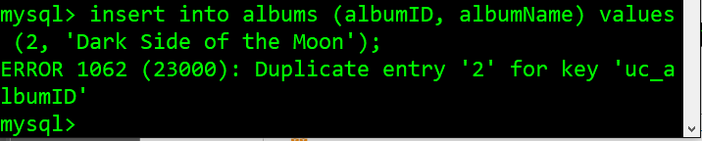
Table constraints
UNIQUE – each row for this column must have a unique value
CREATE TABLE example (
My_id int NOT NULL,
{constraint constraintName} UNIQUE (My_id)
)
CREATE TABLE albums (
albumID int NOT NULL,
FirstName varchar(255),
UNIQUE (albumID)
)
We can specify a constraint and a constraint name. This makes it easier to identify the issue if an error is thrown.
E.g. constraint uc_albumID UNIQUE (albumID)

Slide 20
Table constraints
PRIMARY KEY – combination of NOT NULL and UNIQUE. This column, or a collection of columns (composite key) must have a unique identity for identifying the row quickly and easily. A table can only have ONE primary key, and most tables should have one.
CREATE TABLE example (
My_id int NOT NULL,
PRIMARY KEY (My_id)
)
CREATE TABLE example (
My_id int NOT NULL,
FirstName varchar(255),
CONSTRAINT pk_PersonID PRIMARY KEY (My_id, FirstName)
)

Slide 21
Table constraints
FOREIGN KEY – ensures data for this column matches data in another. A foreign key in a table will point to the primary key in another table. Prevents invalid data as it must match the data in the table it is pointing to and prevents destroying links between tables.
CREATE TABLE example (
My_id int NOT NULL,
FirstName varchar(255),
PRIMARY KEY (My_id)
)
CREATE TABLE example2 (
This_id int NOT NULL,
info varchar(255),
My_id int,
PRIMARY KEY (This_id),
FOREIGN KEY (My_id) REFERENCES example(My_id)
)

Slide 22
Table constraints
CHECK – ensures the value meets a specific conditions
CREATE TABLE example (
My_id int NOT NULL,
Credit int,
CHECK (My_id>0 AND Credit<10000)
)

Slide 23
Table constraints
DEFAULT – gives a default value for a field. This is used if no value is specified when entering data
CREATE TABLE example (
My_id int NOT NULL,
Status varchar(255) DEFAULT ‘ON-HOLD’
)
CREATE TABLE example (
My_id int NOT NULL,
OrderDate date DEFAULT GETDATE()
)

Slide 24
Create
To ‘create’ a new row, we use the INSERT INTO statement to ‘insert’ new data.
INSERT INTO table_name (column1, column2…) VALUES (value1, value2….)
Say we have the following table…
My_ID | F_Name | L_Name | Age | Country
8 | John | Smith | 24 | Norway
9 | Daisy | Day | 21 | England

Slide 25
Create
We create the table like so…
CREATE TABLE people (
My_ID int NOT NULL AUTO_INCREMENT,
F_Name varchar(255),
L_Name varchar(255),
Age int,
Country varchar(255),
PRIMARY KEY (My_ID)
);
We can insert more data like so…
INSERT INTO people (
F_Name, L_Name, Age, Country)
VALUES (‘Alice’, ‘Beacher’, 26, ‘America’);
Notes:
Note auto-increment
This means the value will automatically increment each time and so we don’t need to insert a value when creating a new row

Slide 26
Referential actions
Before we start changing the tables we’ve made you need to understand referential actions
This basically means if we want to update or delete something that would affect a key value in a parent table that has matching rows in a child table you need to consider what you want to do about that
For example, if we deleted a customer row, would we want to delete all orders associated with that customer, assuming the order contains a foreign key that is the customer’s primary key

Slide 27
Referential actions
CASCADE – if you delete or update a record in a parent table it will automatically delete or update the matching row in the child table
CREATE TABLE parent (
ID int NOT NULL,
PRIMARY KEY (ID)
);
CREATE TABLE child (
ID int,
parent_id int,
FOREIGN KEY (parent_id) REFERENCES parent(ID) ON DELETE CASCADE
);

Slide 28
Referential actions
SET NULL – if you delete or update a row from the parent table, set the foreign key column(s) in the child table to NULL. Make sure you have not set columns as NOT NULL if you use this referential action.
CREATE TABLE parent (
ID int NOT NULL,
PRIMARY KEY (ID)
);
CREATE TABLE child (
ID int,
parent_id int,
FOREIGN KEY (parent_id) REFERENCES parent(ID) ON DELETE SET NULL
);

Slide 29
Referential actions
RESTRICT, NO ACTION – these are both the same in MySQL, it will simply reject the delete or update operation for the parent table. This is the default action if ON DELETE or ON UPDATE is not specified.
CREATE TABLE parent (
ID int NOT NULL,
PRIMARY KEY (ID)
);
CREATE TABLE child (
ID int,
parent_id int,
FOREIGN KEY (parent_id) REFERENCES parent(ID) ON UPDATE RESTRICT ON DELETE RESTRICT
);

Slide 30
Referential integrity
Therefore, referential integrity is about relating tables via their content in order to maintain business rules.
This means preventing people from violating business rules via data manipulations.
What if we had a department table that was linked to our employees table and then deleted one of the entries?
Would all employees in the employee table with that department also be deleted?
We can enforce this!

Slide 31
Delete
DROP {DATABASE | SCHEMA} [IF EXISTS] db_name
{DATABASE | SCHEMA} – specify either of these words, it will drop the database
[IF EXISTS] – prevents an error occurring if the database doesn’t exist
db_name – name of the database you want to delete
This will delete all tables within the database as well so use carefully!
DROP DATABASE IF EXISTS test_db

Slide 32
Delete
DROP TABLE [IF EXISTS] table_name
You can list multiple tables if you want to drop more than one
Table data and definitions are all removed so use carefully
If not all tables listed exist MySQL will still drop all tables that do exist
DROP TABLE test_table

Slide 33
Delete
Deleting rows from a table uses the DELETE keyword
To delete rows you should specify a WHERE clause in order to specify what data you want to delete else it will delete everything!
DELETE FROM my_table WHERE status=‘inactive’;
These DELETE commands can become much more complex by using some additional keywords that we will look at later

Slide 34
Delete
DELETE FROM my_table WHERE status=‘inactive’;
My_ID | F_Name | L_Name | Age | Country | Status
8 | John | Smith | 24 | Norway | active
9 | Daisy | Day | 21 | England | inactive
My_ID | F_Name | L_Name | Age | Country | Status
8 | John | Smith | 24 | Norway | active

Slide 35
Update
We can update tables using the ALTER keyword
The ALTER keyword is quite flexible and can be used for a number of things.
Consider the table below…
My_ID | F_Name | L_Name | Age | Country
8 | John | Smith | 24 | Norway
9 | Daisy | Day | 21 | England

Slide 36
Update
To add the ‘Status’ column…
ALTER TABLE my_table ADD Status int
My_ID | F_Name | L_Name | Age | Country
8 | John | Smith | 24 | Norway
9 | Daisy | Day | 21 | England
My_ID | F_Name | L_Name | Age | Country | Status
8 | John | Smith | 24 | Norway
9 | Daisy | Day | 21 | England

Slide 37
Update
We then decide that we don’t want to store Status as a number, a varchar seems more suitable. Of course this won’t change what the table currently looks like, just how it stores the data. MySQL will attempt to convert data where is can.
ALTER TABLE my_table MODIFY Status varchar(255)
My_ID | F_Name | L_Name | Age | Country | Status
8 | John | Smith | 24 | Norway
9 | Daisy | Day | 21 | England

Slide 38
Update
Finally, we decide we don’t want that column at all so we delete it…
ALTER TABLE my_table DROP COLUMN Status
My_ID | F_Name | L_Name | Age | Country | Status
8 | John | Smith | 24 | Norway
9 | Daisy | Day | 21 | England
My_ID | F_Name | L_Name | Age | Country
8 | John | Smith | 24 | Norway
9 | Daisy | Day | 21 | England

Slide 39
Update
We then decide that we don’t want to store Status as a number, a varchar seems more suitable. Of course this won’t change what the table currently looks like, just how it stores the data. MySQL will attempt to convert data where is can.
ALTER TABLE my_table ALTER COLUMN Status varchar(255)
My_ID | F_Name | L_Name | Age | Country | Status
8 | John | Smith | 24 | Norway
9 | Daisy | Day | 21 | England

Slide 40
Update
Of course we can update specific rows as well…
UPDATE table_name SET column1=val1, column2=val2 WHERE columnX = Y;
Don’t forget the WHERE clause else it will update everything in that table!

Slide 41
Update
Imagine John has gotten married and changed his surname. Funnily enough it’s also been over a year since he updated his record and he’s older now.
UPDATE my_table SET L_Name=‘Day’, Age=25 WHERE My_ID=8;
My_ID | F_Name | L_Name | Age | Country
8 | John | Smith | 24 | Norway
9 | Daisy | Day | 21 | England
My_ID | F_Name | L_Name | Age | Country
8 | John | Day | 25 | Norway
9 | Daisy | Day | 21 | England

Slide 42
Read
Accessing data in our database is obviously important!
So first, how do we see what databases are stored on our server?
SHOW {DATABASES | SCHEMA} [LIKE ‘pattern’ | WHERE expression]
SHOW DATABASES or SHOW SCHEMAS will just show all databases
LIKE indicates database names to match
WHERE can be added to select rows using more general conditions

Slide 43
Read
We can list tables either by selecting a database to work with and showing the tables within it, or specifying the database in the FROM clause
SHOW [FULL] TABLES [{FROM | IN} db_name] [LIKE ‘pattern’ | WHERE expression]
FULL – displays additional information on whether it is a table or a view that is returned
FROM, IN – specifies the database you want to see the tables from
LIKE and WHERE act the same as with databases
SHOW TABLES FROM my_database;
USE my_database;
SHOW TABLES;

Slide 44
Read
We can see what columns, and information on the columns using the DESCRIBE keyword
DESCRIBE table_name
This includes information on it’s name, type, whether is can be null, if it’s a key, if it has a default value, and anything additional (e.g. does it auto increment?)

Slide 45
Select
The SELECT statement is used to select data from the database.
You specify the table you want to select from using the FROM keyword:
SELECT * FROM my_table;
* is a wildcard that will select everything.
You can select specific columns by listing them instead
SELECT full_name, age FROM my_table

Slide 46
Select
We can add many more keywords to a SELECT clause to make the data returned more specific
One way of doing this is using the DISTINCT keyword. This will only return unique values of a particular column.
For example, perhaps we want to see all of the cities our customers live at
SELECT DISTINCT city FROM customers;

Slide 47
Select
We can also use the WHERE keyword we have seen used earlier to only return data that matches a specified criteria
SELECT column_names FROM table_name WHERE expression;
This could range from matching strings to testing numerical values
SELECT full_name FROM customers WHERE gender=‘m’;
SELECT full_name, address FROM customers WHERE age>=65;

Slide 48
Select
The WHERE clause can use a number of different operators for comparisons
= equal
<> or != Not equal
> Greater than
>= Greater than or equal to
< Less than
<= Less than or equal to
BETWEEN – within an inclusive range, essentially a combination of great than or equal AND less than or equal
LIKE – search for a pattern
IN – specify multiple possible values for a column (use NOT IN as the opposite)
IS NULL – select everything where this field is null (IS NOT NULL for the opposite)

Slide 49
Select
SELECT full_name WHERE age BETWEEN 18 AND 25;
SELECT full_name WHERE full_name LIKE ‘a%’;
SELECT full_name WHERE full_name LIKE ‘%smith’;
SELECT full_name WHERE full_name LIKE ‘________’;
SELECT full_name WHERE city IN (‘London’,’Manchester’,’Birmingham’);
SELECT full_name WHERE complaints IS NULL;
Notes:
Get all names for customers between 18 and 25
Get all names for customers whose name begins with ‘a’
Get all names where the full_name ends with ‘smith’
Get all names with exactly 8 characters
Get all names whose city is either London, Manchester, or Birmingham

Slide 50
Regular Expressions
Pattern matching as shown using the LIKE keyword can be extended further through regular expressions
Regular expressions pop up in many different languages, and while they are sometimes implemented differently it’s useful to understand how it works
We can use regular expressions to look for particular patterns in data

Slide 51
Regular Expressions
^ - dictates this is at the start of a pattern
$ - dictates this is at the end of a pattern
^a – searches for something beginning in a
a$ – searches for something ending in a
SELECT name FROM customer WHERE name REGEXP ‘^a’;
SELECT name FROM customer WHERE name REGEXP ‘a$’;

Slide 52
Regular Expressions
Like how * is the wildcard for anything when selecting data from MySQL…
The . character is the wildcard in regular expressions, it represents any single character
In regular expressions the * character represents zero or more instances of the preceding character
The + character represents one or more instances of the preceding character
The ? Character matches zero or one instances of the preceding character
SELECT ‘hello’ REGEXP ‘^hello$’;
SELECT ‘hellooooo’ REGEXP ‘^hello$’;
SELECT ‘hellooooo’ REGEXP ‘^hello+’;
SELECT ‘hellooooo’ REGEXP ‘^hello*’;
SELECT ‘hello’ REGEXP ‘hello+’;
SELECT ‘hell’ REGEXP ‘hello+’;
SELECT ‘hell’ REGEXP ‘hello*’;
SELECT ‘hell’ REGEXP ‘hello?’;

Slide 53
Regular Expressions
[a,b,c] – searches for either a, b, or c
[^a,b,c] – searches for anything that isn’t a, b, or c
[a-cF] – searches for either a, b, c, or F
SELECT ‘ban’ REGEXP ‘b[a,i,u,e]n’;
SELECT ‘baaaaan’ REGEXP ‘b[a,i,u,e]n’;
SELECT ‘baaaaan’ REGEXP ‘b[a,i,u,e]+n’;
SELECT ‘bn’ REGEXP ‘b[a,i,u,e]+n’;
SELECT ‘bn’ REGEXP ‘b[a,i,u,e]*n’;
SELECT ‘baaaaan’ REGEXP ‘b[a,i,u,e]*n’;
SELECT ‘ban’ REGEXP ‘b[^o]n’;
SELECT ‘bxn’ REGEXP ‘b[^o]n’;
Notes:
You don’t have to put the commas ☺

Slide 54
Regular Expressions
this|that – matches either ‘this’ or ‘that’
SELECT ‘hello’ REGEXP ‘hello|hi’;
SELECT ‘hi’ REGEXP ‘hello|hi’;
SELECT ‘hip’ REGEXP ‘hello|hi’;
SELECT ‘hip’ REGEXP ‘hello|hi$’;
SELECT ‘hey’ REGEXP ‘hello|hi’;

Slide 55
Regular Expressions
a{1} – searches for 1 a character
a{2,4} – searches for between 2 and 4 a characters
a{0,1} is essentially the same as a?
a{0,} is essentially the same as a*
a{1,} is essentially the same as a+
a{n} – matches precisely ‘n’ instances of a
a{n,} – matches ‘n’ or more instances of a
a{n,m} – matches between ‘n’ and ‘m’ instances of a

Slide 56
Regular Expressions
If you need to search for special characters in regular expressions you need to ‘escape’ them using the \ character. However you also need to escape the \ character itself else it will be treated as literal
For example, since we use the + symbol to denote we want to look for one or more of a character, we can’t simple list it in a regular expression as a normal character
SELECT ‘\hello’ REGEXP ‘\hello’;
SELECT ‘2+3=5’ REGEXP ‘2+3=5’;
SELECT ‘2+3=5’ REGEXP ‘2\+3=5;
SELECT ‘2+3=5’ REGEXP ‘2\\+3=5’;

Slide 57
Select
There are lots of ways we can edit the way our data is output to the screen
If we output data normally we will see the field listed as the name it is given in the table
SELECT full_name from Customer;
Would return a list with the field name of full_name
SELECT full_name AS name from Customer;
Would return a list with the field name of name

Slide 58
Select
The AS keyword is particular useful when we start to look at creating new fields from the ones we currently have e.g. using aggregate functions
SELECT price+tax FROM products;
Would return a list titled ‘price+tax’
SELECT price+tax AS full_price FROM products;
Would return a list titled ‘full_price’

Slide 59
Select
The AS alias is also very useful when your queries start to become more complex or if you just have very long field or table names
This means we can just give them an alias so it’s quicker and easier to refer to them
SELECT test FROM very_long_table_name_that_we_do_not_want_to_write_out_a_lot AS mytable [complex query details];

Slide 60
Select
We can even skip out the AS keyword and simply give a table a name by just listing it afterwards
By setting an alias for a table we can use this alias later to refer to which table we want to refer to, this is especially useful once we start using complex queries that contain many tables
SELECT test FROM very_long_table_name_that_we_do_not_want_to_write_out_a_lot mytable WHERE mytable.column2=50;

Slide 61
Select
The ORDER BY keyword allows us to order output in orders such as lowest to highest
SELECT name, price FROM products ORDER BY price;
This will sort orders by ascending order, so prices at the top will be lowest and prices at the bottom will be the highest. Add the DESC keyword for the opposite way. You can add ASC for ascending order but this is the default option.
SELECT name, price FROM products ORDER BY price DESC;

Slide 62
Select
A keyword that goes very well with ORDER BY is the LIMIT keyword
You can use LIMIT whenever you want just to only see a few fields of output rather than the whole set but it is very useful for answering questions like ‘what is the top 5 x?’ It is also useful for just getting an idea of what the data looks like without having to wait for it all to print…
SELECT name, age FROM customers LIMIT 5;
SELECT name, price FROM products ORDER BY price DESC LIMIT 5;
Notes:
Find the top 5 most expensive products

Slide 63
Select
SUBSTRING allows us to only take part of a string as a result
SUBSTRING(string, position, [length])
SUBSTRING(string FROM position FOR length)
SELECT SUBSTRING(full_name,5,2) FROM customers;

Slide 64
Select
SELECT SUBSTRING(‘Angharad’,5); ‘arad’
SELECT SUBSTRING(‘Angharad FROM 5); ‘arad’
SELECT SUBSTRING(‘Angharad’ 3,5); ‘ghara’
SELECT SUBSTRING(‘Angharad’, -3); ‘rad’
SELECT SUBSTRING(‘Angharad’ -6, 3); ‘gha’
SELECT SUBSTRING(‘Angharad’ FROM -6 FOR 4); ‘ghar’
Notes:
Note – MySQL takes the first character in a substring to be 1 (not 0)

Slide 65
Select
CONCAT lets us combine the output of multiple strings
CONCAT_WS lets us combine the output of multiple strings with a specified separator
CONCAT(column1, column 2)
CONCAT_WS(separator, column1, column2)
CONCAT will return NULL if any value is NULL
CONCAT_WS will skip NULL values

Slide 66
Select
SELECT CONCAT_WS(‘ ‘,first_name, last_name) AS full_name FROM customers;
SELECT CONCAT(first_name, ‘ ‘, last_name) AS full_name FROM customers;
Notes:
These will produce the same thing

Slide 67
Select
There are a number of String functions built in to MySQL
LENGTH(string) – returns the length of the String
CHAR_LENGTH(string) – returns the length in chars
LOWER(string) – returns the string all in lowercase
UPPER(string) – returns the string all in uppercase
TRIM(string) – removes all trailing and leading whitespace
Notes:
LENGTH vs CHAR_LENGTH depends on bit type

Slide 68
Aggregate Functions
There are a number of aggregate functions and they aim to get a single result from a number of rows
COUNT – counts the number of fields → SELECT COUNT(name) FROM customer;
SUM – get the sum total of a field → SELECT SUM(total) FROM orders;
MIN – gets the minimum value from a field → SELECT MIN(total) FROM orders;
MAX – gets the maximum value from a field → SELECT MAX(total) FROM orders;
AVG – gets the average value for a field → SELECT AVG(total) FROM orders;

Slide 69
Aggregates & Grouping
The GROUP BY function is often used in conjunction with aggregate functions
For example, what if you wanted to find the most expensive order made by each customer
GROUP BY brings together sections of our data so we can answer these types of questions
SELECT customer_id, MAX(price) as maxP FROM orders GROUP BY customer_id WHERE rating=5;
You can group by multiple fields and use WHERE clauses

Slide 70
Nested queries
Sometimes you may need to perform a query on some data that has been returned by another query
We can do this using nested queries, where essentially you run a query using information from another query
SELECT product, price FROM products WHERE customer_id IN (SELECT customer_id FROM customer WHERE age > 50) t1;
SELECT customer_id, amount FROM orders WHERE amount = (SELECT MAX(amount) FROM orders) t1;
Notes:
Sub-tables must have an alias (e.g. t1)

Slide 71
Correlated subqueries
In the previous examples you will have noticed you could always run the subquery as a single query on its own
A correlated subquery is a subquery that uses information from the outer query – so the inner query depends on the outer query
It is evaluated once for each row in the outer query
SELECT name, price FROM products p1 WHERE price > ( SELECT AVG(price) FROM products WHERE pLine = p1.pLine );

Slide 72
Joins
Normalisation makes the use of joins necessary, joins are used to combine different tables together
Here you can see we have the Cust_id value in both tables, but imagine if we wanted to know the answer to what is the name of the person who made the order with the Order_id 4
We could answer this with two separate queries…
Cust_id | Name | Country
A | Aidan | US
B | Brian | CA
C | Cathy | MX
D | Daisy | DE
Order_id | Cust_id | Total
1 | A | 1539
3 | A | 6352
4 | B | 1456
5 | Z | 2137
Notes:
See normalisation later in the modelling section of the course

Slide 73
Joins
SELECT cust_id FROM orders WHERE order_id=4;
B
SELECT Name FROM customers WHERE cust_id=B;
Brian
Cust_id | Name | Country
A | Aidan | US
B | Brian | CA
C | Cathy | MX
D | Daisy | DE
Order_id | Cust_id | Total
1 | A | 1539
3 | A | 6352
4 | B | 1456
5 | Z | 2137

Slide 74
Joins
SELECT * FROM customers c JOIN orders o ON c.cust_id = o.cust_id;
Cust_id | Name | Country
A | Aidan | US
B | Brian | CA
C | Cathy | MX
D | Daisy | DE
Order_id | Cust_id | Total
1 | A | 1539
3 | A | 6352
4 | B | 1456
5 | Z | 2137
Cust_id | Name | Country | Order_id | Total
A | Aidan | US | 1 | 1539
A | Aidan | US | 3 | 6352
B | Brian | CA | 4 | 1456
Notes:
Key point here you’ll note is that we start to use aliases for our tables
This makes it shorter to refer to table fields later in the query
In fact, it is very necessary here since we are referring to 2 fields with the same name in different tables, so we have to specify which table it is coming from

Slide 75
Joins
In a join you must always specify what you are joining on. By that, we mean what is the field that the tables will match up on – what is the same. That way we can ‘match’ information on a particular column.
SELECT * FROM customers c JOIN orders o ON c.cust_id = o.cust_id;
Cust_id | Name | Country
A | Aidan | US
B | Brian | CA
C | Cathy | MX
D | Daisy | DE
Order_id | Cust_id | Total
1 | A | 1539
3 | A | 6352
4 | B | 1456
5 | Z | 2137

Slide 76
Joins
Theoretically we can join any two tables together
SELECT * FROM table1 JOIN table2 ON table1.Letter=table2.City;
SELECT * FROM table1 JOIN table2 ON table1.Number=table2.isTrue;
Number | Letter | Other
7 | B | N31E
1 | M | L8HNS
isTrue | City | SeaLevel
0 | London | 1.6
1 | Paris | 5.1
Notes:
The first query wouldn’t return anything
But the second query would find a match on the second entry for both!

Slide 77
Joins
Usually logic will dictate whether or not you should be joining tables as to what information you need
District | Address
SOUTHERN | 0_Block_of_SOUTHPARK_AV
RICHMOND | 1400_Block_of_CLEMENT_ST
BAYVIEW | 1400_Block_of_VANDYKE_AV
SOUTHERN | 1100_Block_of_MISSION_ST
Category | Date | Address
EMBEZZLEMENT | 17/11/14 | 1400_Block_of_CLEMENT_ST
BRIBERY | 12/08/12 | 1500_Block_of_15TH_ST
BRIBERY | 23/10/08 | 1100_Block_of_MISSION_ST
BRIBERY | 01/08/13 | 800_Block_of_MARKET_ST
Notes:
Here we would just join on Address if we wanted to find out what district a crime occurred in

Slide 78
Inner Joins
The example covered earlier is called an Inner Join
It will only connect rows where there is a match on whatever you are joining in BOTH tables
Cust_id | Name | Country
A | Aidan | US
B | Brian | CA
C | Cathy | MX
D | Daisy | DE
Order_id | Cust_id | Total
1 | A | 1539
3 | A | 6352
4 | B | 1456
5 | Z | 2137
Cust_id | Name | Country | Order_id | Total
A | Aidan | US | 1 | 1539
A | Aidan | US | 3 | 6352
B | Brian | CA | 4 | 1456

Slide 79
Outer Joins
There are a number of other types of join called ‘Outer’ joins
The ‘Left Outer Join’ will produce a result that has a row for every row in the ‘left’ table (the one you write first in the query) regardless of whether there is a match in the ‘right’ table, and fill any other field with NULL values
The ‘Right Outer Join’ will produce a result that has a row for every row in the ‘right’ table (the one you write first in the query) regardless of whether there is a match in the ‘left’ table, and fill any other field with NULL values

Slide 80
Inner Joins
Cust_id | Name | Country
A | Aidan | US
B | Brian | CA
C | Cathy | MX
D | Daisy | DE
Order_id | Cust_id | Total
1 | A | 1539
2 | C | 1871
3 | A | 6352
4 | B | 1456
5 | Z | 2137
SELECT c.Cust_id, Name,
Total FROM customers c
JOIN orders o
ON c.Cust_id = o.Cust_id;
Cust_id | Name | Total
A | Aidan | 1539
A | Aidan | 6352
B | Brian | 1456
C | Cathy | 1871
Notes:
Notice c.cust_id – this means we are taking the cust_id field from the customers table, so if it doesn’t appear there it will be NULL in the output!

Slide 81
Left Outer
Cust_id | Name | Country
A | Aidan | US
B | Brian | CA
C | Cathy | MX
D | Daisy | DE
Order_id | Cust_id | Total
1 | A | 1539
2 | C | 1871
3 | A | 6352
4 | B | 1456
5 | Z | 2137
SELECT c.Cust_id, Name,
Total FROM customers c
LEFT OUTER JOIN orders o
ON c.Cust_id = o.Cust_id;
Cust_id | Name | Total
A | Aidan | 1539
A | Aidan | 6352
B | Brian | 1456
C | Cathy | 1871
D | Daisy | NULL

Slide 82
Right Outer
Cust_id | Name | Country
A | Aidan | US
B | Brian | CA
C | Cathy | MX
D | Daisy | DE
Order_id | Cust_id | Total
1 | A | 1539
2 | C | 1871
3 | A | 6352
4 | B | 1456
5 | Z | 2137
SELECT c.Cust_id, Name,
Total FROM customers c
RIGHT OUTER JOIN orders o
ON c.Cust_id = o.Cust_id;
Cust_id | Name | Total
A | Aidan | 1539
A | Aidan | 6352
B | Brian | 1456
C | Cathy | 1871
NULL | NULL | 2137
Notes:
Notice c.cust_id – this means we are taking the cust_id field from the customers table, so if it doesn’t appear there it will be NULL in the output!

Slide 83
Left Outer
Cust_id | Name | Country
A | Aidan | US
B | Brian | CA
C | Cathy | MX
D | Daisy | DE
Order_id | Cust_id | Total
1 | A | 1539
2 | C | 1871
3 | A | 6352
4 | B | 1456
5 | Z | 2137
SELECT c.Cust_id, Name,
Total FROM customers c
LEFT OUTER JOIN orders o
ON c.Cust_id = o.Cust_id WHERE o.Total IS NULL;
Cust_id | Name | Total
D | Daisy | NULL
Notes:
IS NULL example

Slide 84
Union
UNION is used to join the outputs from SELECT statements into a single result set provided they have the same number and order of columns with similar data types
Think of it as similar to a JOIN, where a JOIN connects data across rows, UNION connects data down through columns
SELECT columns FROM table1 UNION [ALL] SELECT columns FROM table2;
By default, UNION only returns distinct values, adding the ALL keyword will keep any duplicates

Slide 85
Union
SELECT City, Country FROM Customers WHERE Country=‘UK’ UNION [ALL] SELECT City, Country FROM Suppliers WHERE Country=‘UK’;
Cust_id | City | Country
62817 | London | UK
62818 | Newcastle | UK
62819 | Paris | France
Supp_id | City | Country
152 | Manchester | UK
153 | Concord | US
154 | Berlin | Germany
Notes:
The result will usually have the same column names as the ones specified in the first select statement

Slide 86
Views
Views can be thought of as a pseudo-table
Views are defined from existing tables/views in order to make the data easier to work with/manage
Views are essentially reusable SELECT statements that avoid us needing to type the whole statement
CREATE VIEW viewname(col1, alt_name_col2, calc_col) AS SELECT col1, col2, (col3/col4*100) AS calc_col FROM tablename;
DROP viewname

Slide 87
Views
Views will be up to date with the most recent data at any point they are accessed, not just the data at time of creation
CREATE VIEW discontinued_products (name, supplier) AS SELECT name, suppier FROM products WHERE status=‘discontinued’;

Slide 88
Views
You can update views as well if you want to change it. Use the OR REPLACE keyword and either a view will be created if it doesn’t already exist or if it does exist it will be replaced by the new one. Or you can use the ALTER VIEW command.
CREATE OR REPLACE VIEW discontinued_products (name, supplier) AS SELECT name, suppier FROM products WHERE status=‘discontinued’;
ALTER VIEW discontinued_products……;

Slide 89
Views
You can then use views to see information
SELECT * FROM discontinued_products;

Slide 90
Administration
We need to create users who we allow access to our mysql instance using a username and password to log in. We also define where they can log in from, what host we expect them to be accessing it from. So, for example, our employees can only access the database from their work computer on the work network.
It is important to ensure that the correct users have access to each table
CREATE USER ‘my_user’@’host’ IDENTIFIED BY ‘my_password’;

Slide 91
Administration
It’s possible to allow people to log in specifically from the same host as the server
We can also used the wildcard ‘%’ to specify any host
CREATE USER ‘my_user’@’localhost’ IDENTIFIED BY ‘my_password’;
CREATE USER ‘other_user’@’%’ IDENTIFIED BY ‘pass’;

Slide 92
Administration
Some users will need access to tables that others will not, so for giving access to table we use the GRANT keyword
We can also grant different types of access which are called privileges
In order to grant privileges we, the user trying to grant, must have that privilege we are trying to grant and the GRANT OPTION privilege
GRANT privilege ON table TO user [WITH GRANT OPTION];

Slide 93
Privileges
ALL PRIVILEGES – grants all privileges except GRANT OPTION
ALTER – allows use of ALTER TABLE
CREATE – allows database and table creation depending on where it’s granted
CREATE USER – allows creating, dropping, renaming, and revoking all privileges on users
DELETE – allows use of DELETE
DROP – allows use of DROP
GRANT OPTION – allows user to grant privileges to other users
INSERT – allows use of INSERT
REFERENCES – allows foreign key creation
SELECT – allows use of SELECT
SHOW DATABASES – allows use of SHOW DATABASES
UPDATE – allows use of UPDATE

Slide 94
Administration
GRANT ALL ON mydatabase.mytable TO ‘myuser’@’localhost’;
GRANT SELECT, INSERT, UPDATE ON mydb.mytbl TO ‘myuser’@’%’;
GRANT ALL on mydatabase.* TO ‘myuser’@’localhost’;
GRANT ALL ON *.* to ‘myuser’@’localhost’ WITH GRANT OPTION;
Notes:
* Is the wildcard – so it will grant privileges on all tables in the mydatabase database
*.* gives global privileges

Slide 95
Administration
To remove privileges use the following query with the CASCADE to remove additional privileges given from the WITH GRANT OPTION
REVOKE privilege ON tablename FROM user [CASCADE];

Slide 96
Administration
SHOW GRANTS FOR ‘myself’@’%’;
CREATE USER ‘accounts’@’myhost’ IDENTIFIED BY ‘mypass’;
GRANT SELECT, INSERT, UPDATE, DELETE ON customer.* TO ‘accounts’@’myhost’;

Slide 97
Modelling

Slide 98
Designing the Database
Before we start creating a database, we should model it first and test it against any requirements we may already have.
For this we will be using an entity relationship diagram
Consider:
What data it will be storing
Who will be using it
What the data will be used for
Do you have any documentation to work with already?

Slide 99
Designing the Database
Entity
An entity could be an object, person, event or abstraction.
An entity must be relevant.
Could be referred to as an ‘instance’ of an entity type.
Entity Type
An entity type is a class of objects.
Entities represented within an entity type have the same characteristics.
The Entity Type ‘Person’ has the entities ‘James’ and ‘Jo’

Slide 100
Objects First vs. Tables First
With Objects First you start by creating the code and then engineering the database later.
Libraries like Java EE’s JPA API provides a specification for reverse engineering database from code.
The advantage of this method is that we can change the database structure on the fly as it does not yet exist.
With Tables First you start by engineering the database and then creating the code later.
Cheaper if there is already an existing database or if there are multiple systems that will rely on the database.
The advantage is that we have a rigid structure in place and other developers know exactly what they are working with.

Slide 101
Entity Relationship Diagrams
ERDs are used to show the design of a database schema with names, columns and relationships.
The ERD focuses on the DATA not code objects.
When creating the ERD, think in terms of the end user, use your user stories to include the relevant data in a logical format.
Don’t include unnecessary information.
MySQL Workbench has a good ERD modelling tool built in that we will look at later

Slide 102
Cardinality – entity relationships
Symbol | Meaning
 | One and Only One
 | Zero or One
 | One to Many
 | Zero to Many

Slide 103
ERD Creation Steps
Identify the Entity
Identify the Attributes
Identify the Primary Keys
Identify the relationships
Identify the cardinality
Draw a Draft
Map the Attributes
Refine the ERD
Take your user stories.
Pick one.
Follow these steps using the information in the user story.
When you’ve finished step 8, Pick another one.
Repeat till there are no more user stories.
Most user stories will need to be looked at more than once.
Don’t add anything that isn’t in a user story.

Slide 104
1. Identify the Entity
“As a customer I want to find books by a specific author to find other works by that author I may be interested in.”
Here we can identify two entities: Book and Author.

Slide 105
2. Identify the Attributes
“As a customer I want to find books by a specific author to find other works by that author I may be interested in.”
Here we can identify that for book we have an attribute of author.
Because we are looking at both entities we can also see that author has an implied attribute of name.
We don’t have to identify an attribute in every user story, this will be one of several stories so we aren’t expecting to find everything.

Slide 106
3. Identify the Primary Keys
“As a customer I want to find books by a specific author to find other works by that author I may be interested in.”
Some entities may not have a single attribute that is always unique.
In these cases we can think about whether or not we could use multiple attributes as a composite key.
Here we can identify that for book we don’t actually have a primary key that we can identify in this story.
We could make the assumption here that author’s identified attribute of name could be a primary key.
We don’t have to identify a primary key in every user story, this will be one of several stories so we aren’t expecting to find everything.

Slide 107
4. Identify the Relationships
“As a customer I want to find books by a specific author to find other works by that author I may be interested in.”
Here we can identify that there is a relationship between book and author.
Again, we aren’t expecting to find everything in one story.
We can create a Relationship Matrix to help us see the relationships.
Not every entity will have a relationship with every other entity.
 | Book | Author | Publisher
Book |  | Is Written By | Is Published By
Author | Writes
Publisher | Publishes

Slide 108
5. Identify the Cardinality
“As a customer I want to find books by a specific author to find other works by that author I may be interested in.”
A Book is written by One and Only One Author.
An Author writes One Or More Books.
Here we can identify that an author can write many books.
Because we can say that an author isn’t an author until they have written a book we can say that the relationship is One to Many.
We can write these out so that they are easy to see.
Later user stories may change the cardinality.

Slide 109
6. Draw the Draft
Book
Author

Slide 110
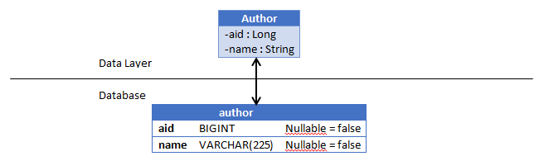
7. Map the Attributes

Slide 111
8. Refining the ERD
author
aid | BIGINT | 20
name | VARCHAR | 225
book
isbn | BIGINT | 13
title | VARCHAR | 300

Slide 112
Normalization
Normalization does a number of things for our database including:
Eliminating non-atomic values that impact performance or require complex code.
Eliminating redundant data.
Removes modification anomalies.
The aim is to organise our database to minimise data redundancy.
Tables should generally be normalised to the third normal form and the normal form of a database is the lowest normal form of all its tables.
Normalization should be done when we are still creating our ERD.

Slide 113
First Normal Form
Tables MUST have a key that all attributes depend on.
Every column stores ONLY atomic values.
cust_ID | fName | lName | phoneNumber
123 | Robert | Ingram | 012767128282
546 | Jane | Wright | 037197118422 0781551627
756 | Maria | Fernandez | 091641247291
If we are recording telephone numbers and a customer has two numbers we need a way of storing this.
We cant allow phoneNumber to contain more than one value as this would not conform to 1NF!
To Conform with 1NF we must add a new row to allow for multiple phone numbers
cust_ID | fName | lName | phoneNumber
123 | Robert | Ingram | 012767128282
546 | Jane | Wright | 037197118422
546 | Jane | Wright | 0781551627
756 | Maria | Fernandez | 091641247291

Slide 114
Second Normal Form
The Whole Key,
Must meet all requirements of First Normal Form
Non-prime attributes must not depend on a subset of any candidate key. No partial dependency
If we were to take our phone number table phoneNumber is dependent on a subset of the primary key: fName and lName
By separating these into separate tables we now conform to 2NF and 1NF
cust_ID | fName | lName | phoneNumber
123 | Robert | Ingram | 012767128282
546 | Jane | Wright | 037197118422
546 | Jane | Wright | 0781551627
756 | Maria | Fernandez | 091641247291
cust_ID | phoneNumber
123 | 012767128282
546 | 037197118422
546 | 0781551627
756 | 091641247291
cust_ID | fName | lName
123 | Robert | Ingram
546 | Jane | Wright
756 | Maria | Fernandez

Slide 115
Third Normal Form
And Nothing but the Key.
Must conform to 1 & 2NF
All non-prime attributes must not be transitively dependent on every key of R
Transitive dependency is where X determines Z indirectly because X determines Y and Y determines Z (X -> Z because X -> Y -> Z)
In this example Tournament and year determines winner DOB indirectly through winner.
Tournament | Year | Winner
Indiana Invitational | 1998 | Al Fredrickson
Cleveland Open | 1999 | Bob Albertson
Des Moines Masters | 1999 | Al Fredrickson
Indiana Invitational | 1999 | Chip Masterson
Tournament | Year | Winner | Winner DOB
Indiana Invitational | 1998 | Al Fredrickson | 21 July 1975
Cleveland Open | 1999 | Bob Albertson | 28 September 1968
Des Moines Masters | 1999 | Al Fredrickson | 21 July 1975
Indiana Invitational | 1999 | Chip Masterson | 28 September 1968
Winner | Winner DOB
Al Fredrickson | 21 July 1975
Bob Albertson | 28 September 1968
Chip Masterson | 28 September 1968

Slide 116
Higher Normal Forms
Boyce-Codd Normal Form (BCNF)
Fourth Normal Form
Fifth Normal Form
Domain-Key Normal Form
Sixth Normal Form

Slide 117
Denormalization
Denormalization is done after the database has been normalised.
It can improve read performance of a database if you have created many separate tables causing multiple joins to slow down operations.
It can also be useful if you are migrating some data to another type of database such as MongoDB.

Slide 118
Workbench Modelling

Slide 119
MySQL Workbench Modelling
Workbench is a user interface you can use to interact with your MySQL server
You can set up MySQL to run as a Windows service in the background
The first page you will see allows you to create many different things:
Connections – these are connections to a MySQL server that will hold your information
Models – these are the ERDs we discussed earlier
Scripts – these can be collections of SQL queries in order to get information

Slide 120
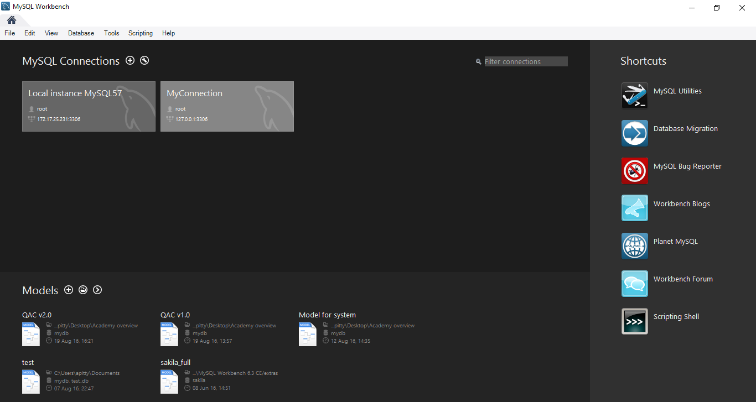
MySQL Workbench Modelling

Slide 121
MySQL Workbench Modelling
To create a new model you can just click on the plus button near the Models section or open up a model to see its current state
You can then click on New Model to create your new ERD or EER diagram (extended entity relationship diagram)
From here you will be presented with a grid on which to place your tables and make your database model
You can then forward engineer these models which will then generate SQL scripts in order to create the database in MySQL

Slide 122
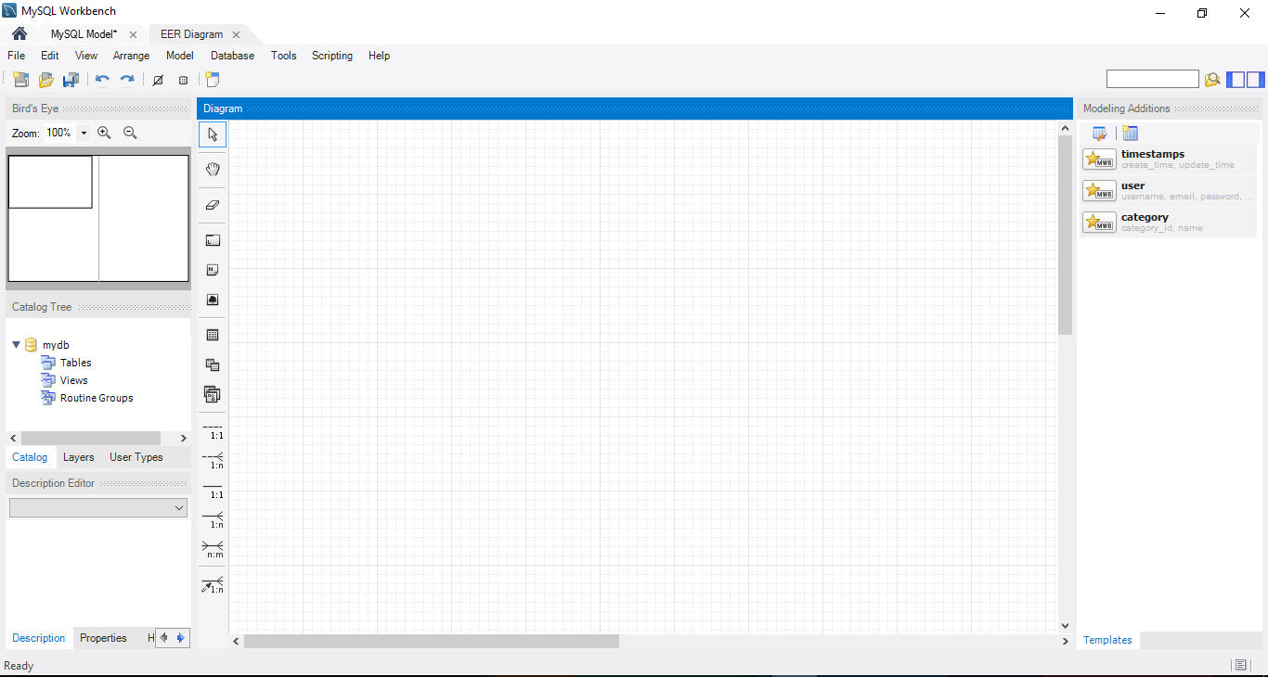
Notes:
Catalog tree – can open up each of these areas to see things in a tree diagram
Canvas to add tables etc to
Use the buttons down the side of the canvas to click and place things on the canvas

Slide 123
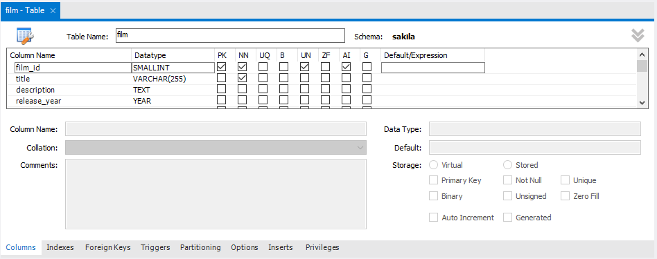
Double-click on a table to bring up an editing tab
Notes:
Give it a name
Add columns and specify constraints, data types etc

Slide 124
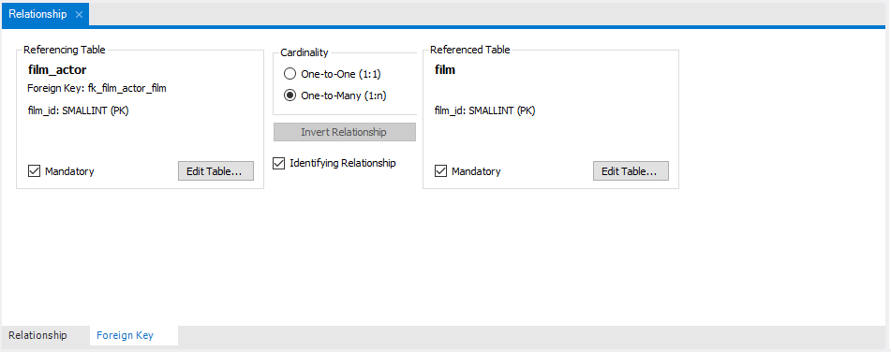
Double-click on a relationship to bring up an editing tab
Notes:
Give it a name
Add columns and specify constraints, data types etc

Slide 125
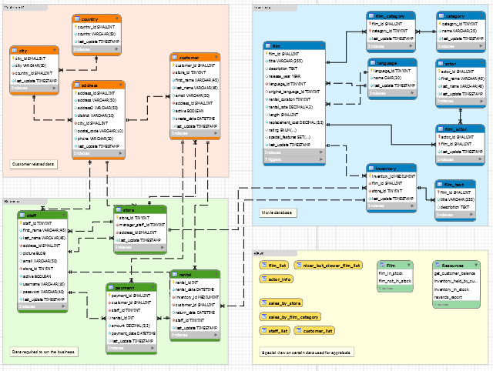
MySQL ships with a good example of a database model – the sakila data
First thing you will notice is the different coloured sections – these are layers and are a way of organising our data
Here we have Views, Customer data, Inventory (movie) data, and Business data

Slide 126
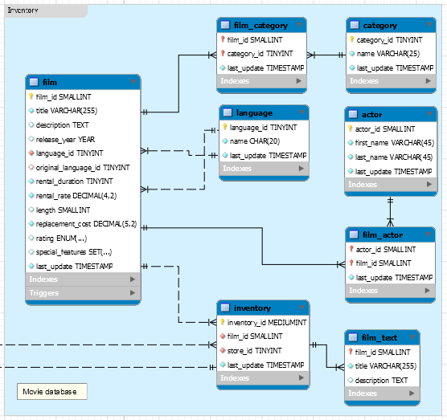
Let’s look in detail at the movie layer but be aware it has connections to other layers too
Solid black lines represent identifying relationships, dashed lines represent non-identifying relationships
The difference is identifying relationships mean that the primary key of the parent is also part of the primary key of the child

Slide 127
Look specifically at the film_actor table – it’s primary key will be a composite key of the actor_id and film_id – the primary keys from the parent tables
This essentially means that the film_actor cannot have an instance that does not include a valid key that matches up with the film and actor tables

Slide 128
The film_actor table is essentially acting as a bridge between films and actors since this would be a many-to-many relationship
MySQL would put these here automatically if you tried to create a m:m relationship
However we’ve also given it a unique piece of information called last_update so we know when it’s been updated for that record

Slide 129
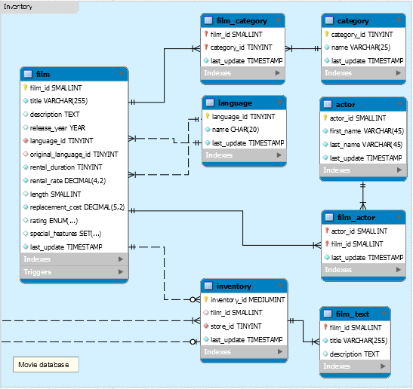
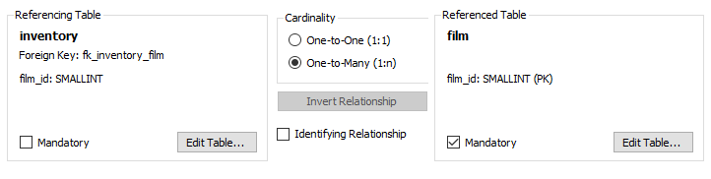
You can change the relationships to have 0 – 1 or 0 – many relationships as well
You can change this in the relationship editing table

Slide 130
Each column in a table has a symbol next to it so you can easily identify what sort of field it is
Primary key
Primary key that is also a Foreign Key
NOT NULL Attribute
NOT NULL Foreign Key
Attribute which can be NULL
Foreign Key which can be NULL
Notes:
Essentially a foreign key will be part of the primary key if it is an identifying relationship, it will just be a foreign key if it is not identifying

Slide 131
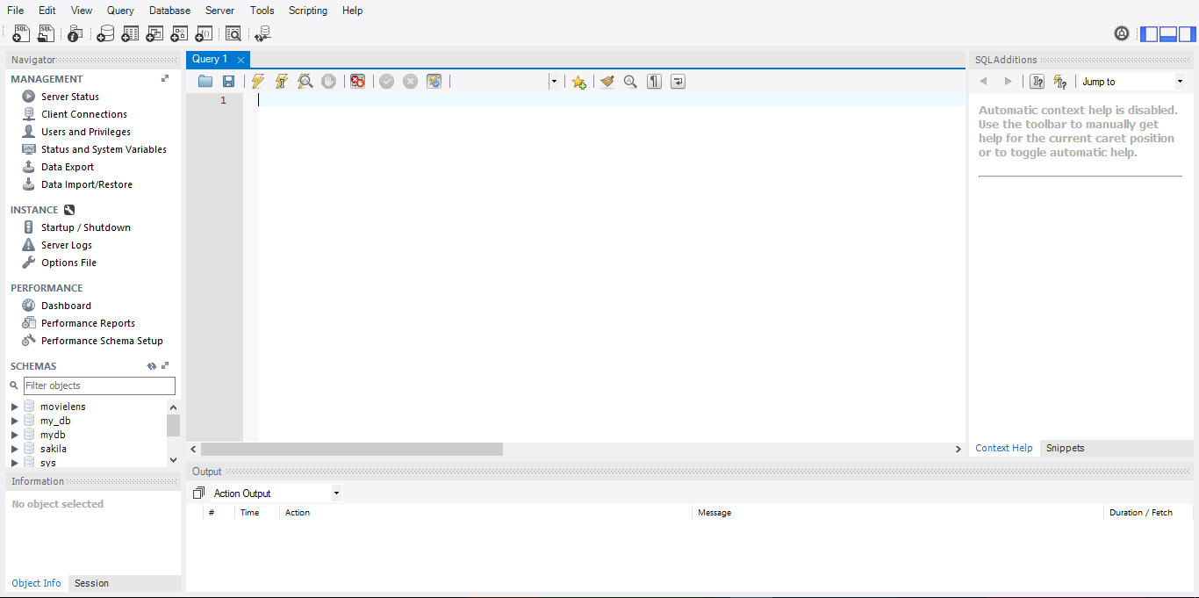

Slide 132
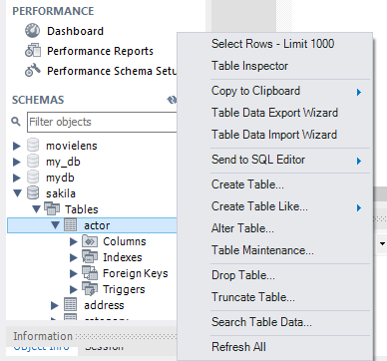
You’ll notice in schemas you can expand each of the sections of your databases, all the way down to the columns
If you right click on it you can get a number of additional options such as returning the first 1000 rows – a quick and easy way of getting an idea of what’s in your table

Slide 133
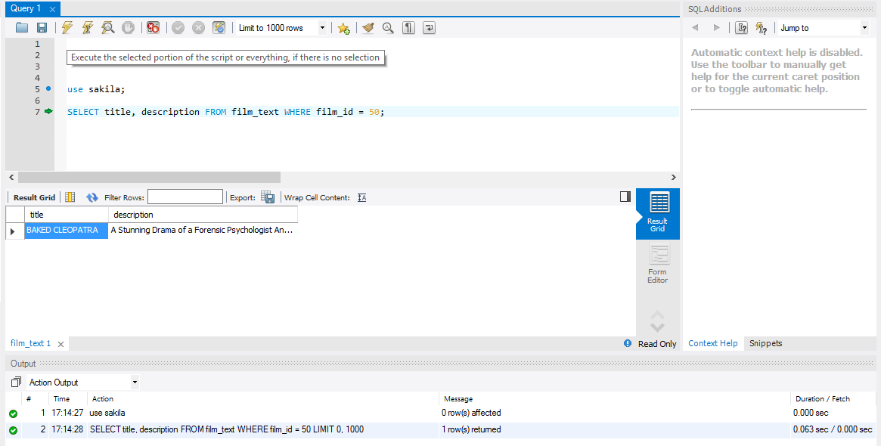

Slide 134
Operational Database
Generally a business will have an ‘operational’ database – this is where all the ‘current’ data is stored that the business processes require to function
This would be an OLTP (On-Line Transaction Processing) database
Main aim is to have quick query processing where many different people may be accessing the data
Characterised by a large number of short INSERT, UPDATE, or DELETE commands
Effectiveness measured by number of transaction per second

Slide 135
Data Warehouse
Operational databases are used for current transactions and undergo frequent changes
Data warehouses provide us with historical, consolidated data
The data warehouse often contains data from many sources which can be OLTP databases
A data warehouse equips us with OLAP (On-Line Analytical Processing) capabilities

Slide 136
Data Warehouse
Key features
Subject oriented
Not focussed on ongoing business operations but more a ‘subject’ of it e.g. products, sales…
Integrated
Integrates data from a range of other sources for effective analysis
Time Variant
Historical data from different times
Non-volatile
Previous data is not erased when new data is added

Slide 137
Operational Database
Generally a business will have an ‘operational’ database – this is where all the ‘current’ data is stored that the business processes require to function
This would be an OLTP (On-Line Transaction Processing) database
Main aim is to have quick query processing where many different people may be accessing the data
Characterised by a large number of short INSERT, UPDATE, or DELETE commands
Effectiveness measured by number of transaction per second

Slide 138
OLTP
Master data transactions
Business Processes
Business Strategy
Operations
OLAP
Decision making
Information
Data mining
Analytics
Data Warehouse

Slide 139
OLTP | OLAP
Operational data (day to day) | Consolidated data from various sources (historical)
Controls and runs fundamental business activities | Planning, problem solving, decision making
Short and fast inserts, updates, and standard, simple queries from users in order to return small amount of data (data in) | Periodic, long-running batch jobs, complex queries involving aggregation
Typically fast | May take many hours
Space required can be quite small if regularly archived | Larger amount of space required
Highly normalised | Typically denormalised with fewer tables, may use schemas such as star or snowflake
Back up frequently as the data is vital for business operations | May simply reload data from OLTP as a recovery method, less frequently back up
OLTP & OLAP

Slide 140
Data Warehouse
Data warehouses tend to lean towards dimensional modelling rather than relational modelling, which is a step towards OLAP cubes
We will explore a few of these schema types and we can create these within MySQL the same as others, it is simply a useful structure and a different way of thinking through the data

Slide 141
Data warehousing tables
Fact table
Measurements, metrics, or facts of a business process
Usually consists of a few foreign keys and a few additional fact attributes
Primary key is usually a composite made up of all of its foreign keys
Often just made of numerical attributes
Usually very long i.e. there will be lots of records contained within, but quite thin i.e. not very many columns
A fact table is quite similar to the tables created for many-to-many relationships that we’ve seen earlier!

Slide 142
Data warehousing tables
Dimension table
Categorises facts, essentially providing labels for the fact table
Often used for ‘slice and dice’ operations. Slicing filters data, Dicing groups the data
Usually have more descriptive elements compared to a fact table e.g. text comments
Will have fewer records than a fact table and will more often have a short and stout structure

Slide 143
Star schema
Usually has a fact table at the centre, surrounded by dimension tables
They are denormalised which makes a number of different queries much faster or simpler
Works well with OLAP cubes
May have issues with data integrity so are often loaded in extremely controlled way
Tend to be more purpose built for a particular view of the data and therefore less flexible than other schemas

Slide 144
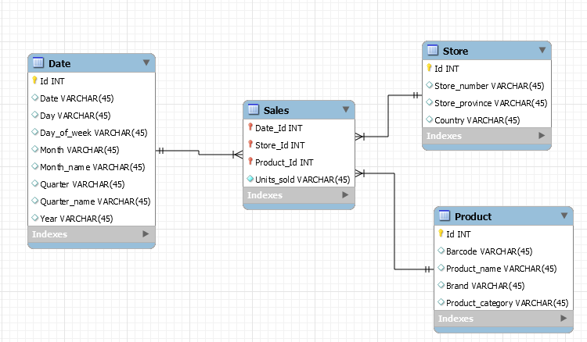
Star schema
Notes:
Sales = fact
Date = dimension
Store = dimension
Product = dimension

Slide 145
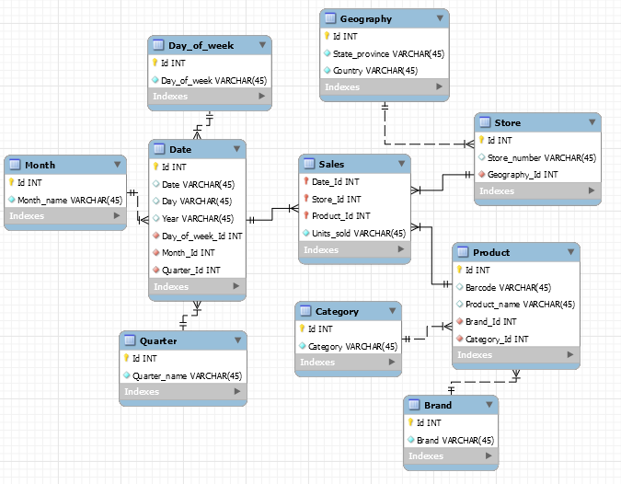
Snowflake schema
Notes:
Snowflake schema means that the dimension tables may end up with some degree of normalisation, the fact table remains the same, but we now add more of the benefits of normalisation to improve data redundancy

Slide 146
Conclusion
More questions?
Please fill in the evaluation form
http://evaluation.qa.com/

Slide 147
Thank you
QA hopes you enjoyed your course,
as much as we enjoyed teaching you.

